Slide 1
Impact of Elevated Base Stations on the Ultra-Dense Networks
Hewon Cho, Chenxi Liu, Jemin Lee , Taegyun Noh, and Tony Q. S. Quek
BongSang Kim
25/April/2019
UGRP
Notes:
표지

Slide 2
Keywords
Elevated BSs
LoS(Line of Sight)/NLoS
Stochastic geometry
Coverage probability
Notes:
키워드

Slide 3
UDN Characteristics
-The distance between BS and UE is small
The height of BSs cannot be ignored
The possibilities of having LoS propagation increases.
Notes:
UDN 특성
잠깐 UDN에 대해 간략히 복습하자면
@#@#@#@#@_@

Slide 4
Former studies models
Assumption: the probability of LoS propagations decreases as the antenna height of BSs increases -unlikely to be valid in practice
- BSs with a higher height are more likely to establish the LoS path towards the UEs.
Assumption: equal height for all BSs-not realistic.
→heights of buildings should be different and random
Notes:
Former studies 한계, 문제점?

Slide 5
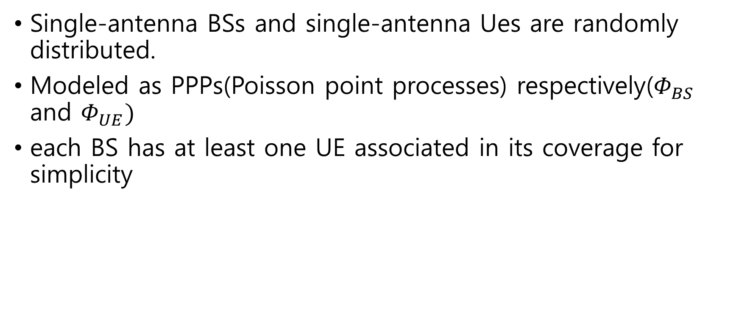
System Model
Single-antenna BSs and single-antenna Ues are randomly distributed.
Modeled as PPPs(Poisson point processes) respectively($Φ_{BS}$ and $Φ_{UE})$
each BS has at least one UE associated in its coverage for simplicity

Slide 6


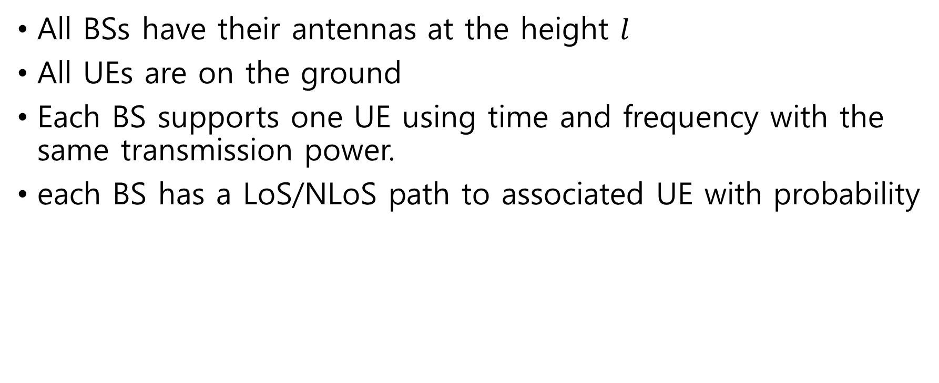
System Model-Network Description
All BSs have their antennas at the height $l$
All UEs are on the ground
Each BS supports one UE using time and frequency with the same transmission power.
each BS has a LoS/NLoS path to associated UE with probability

Slide 7
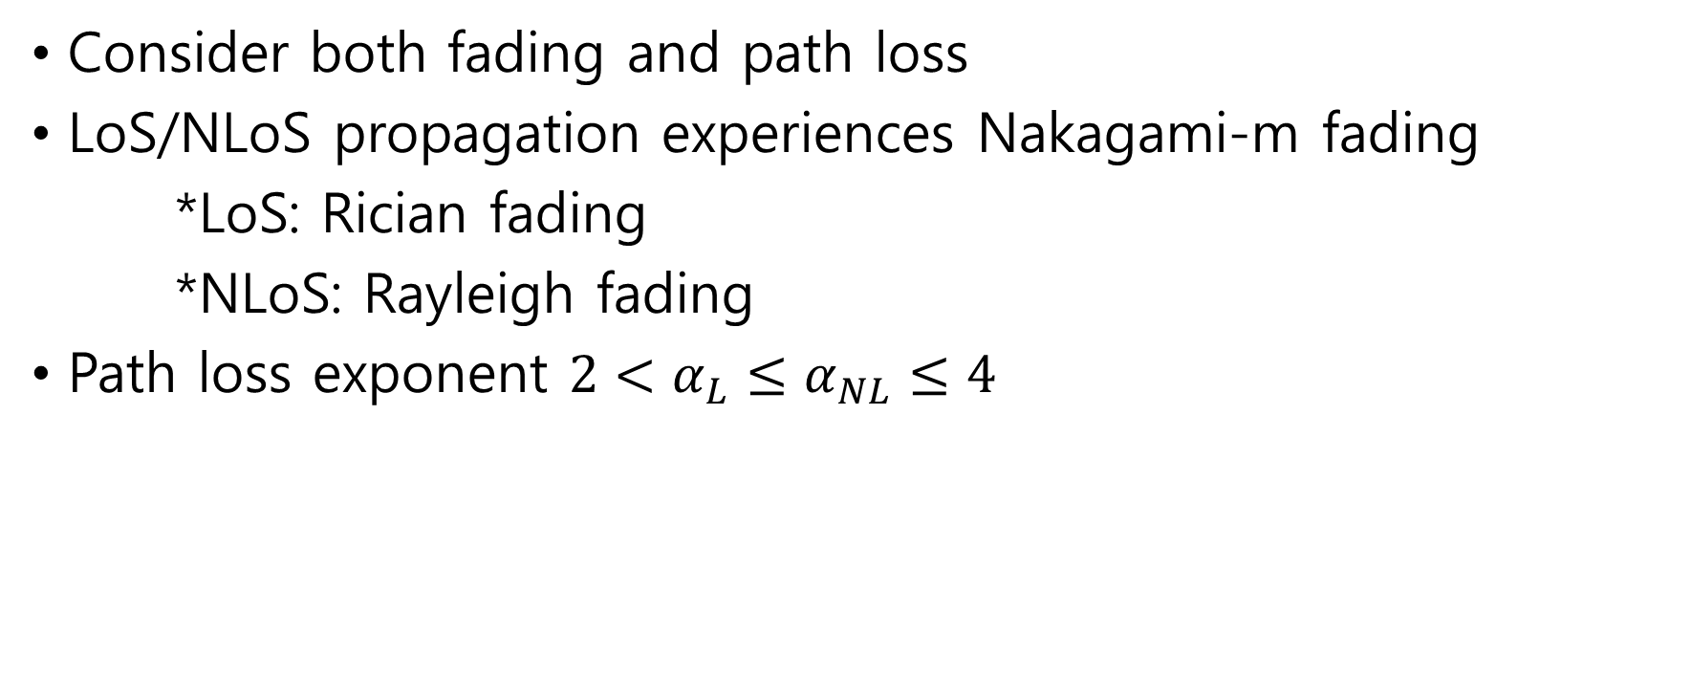
System Model-Network Description
Consider both fading and path loss
LoS/NLoS propagation experiences Nakagami-m fading
*LoS: Rician fading
*NLoS: Rayleigh fading
Path loss exponent ${2<α}_{L}≤α_{NL}≤4$

Slide 8
BS Association Rule
the path loss exponents are different for LoS and NLoS propagations
→the signal strength of the nearest BS is not always the strongest one
cf) conventional model : the signal strength of the nearest BS is the strongest one
Consider BS with average strongest received power.

Slide 9
BS Association Rule
Conventional PDF of the distance between UE and BS canoot be applied to the system.
Should be consider LoS/NLoS propagation respectively.

Slide 10
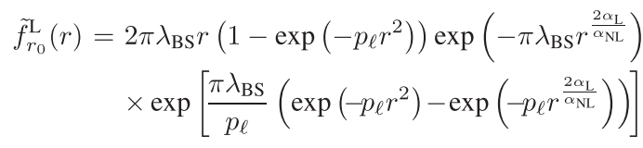
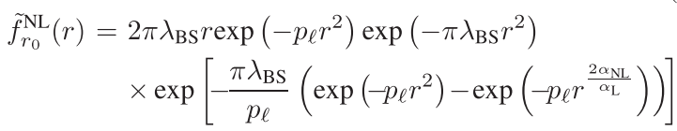

BS Association Rule
The approximated PDFs of $r_{0}$
LOS
NLOS
$p_{l}$ : tunable value determined by the BS height $l$

Slide 11

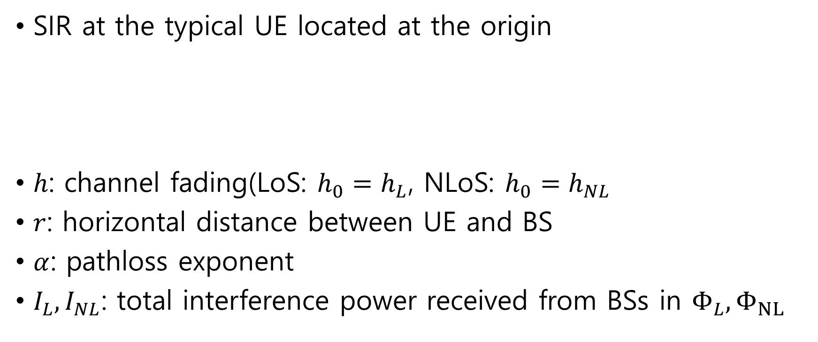
Signal-to-Interference Radio
SIR at the typical UE located at the origin
$h$: channel fading(LoS: $h_{0}=h_{L}$, NLoS: $h_{0}=h_{NL}$
$r$: horizontal distance between UE and BS
$α$: pathloss exponent
$I_{L}, I_{NL}$: total interference power received from BSs in $Φ_{L}, Φ_{NL}$

Slide 12
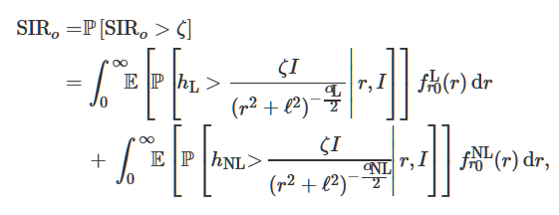
Coverage Probability analysis
The coverage probability of the system is

Slide 13
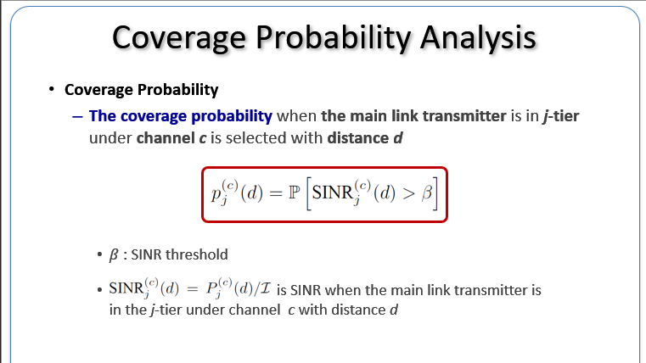

Slide 14
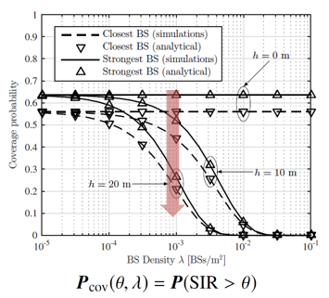
Numerical Results

Slide 15
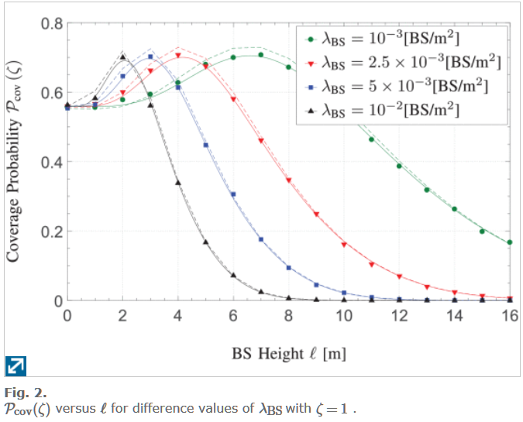
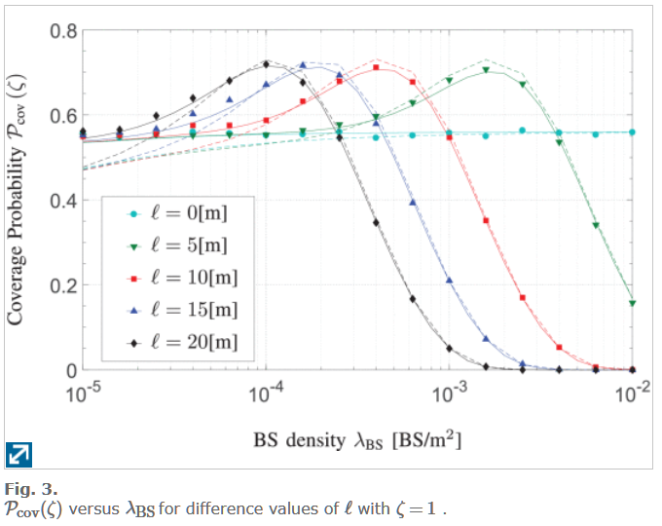
Numerical Results

Slide 16
Questions?
Thank you

